Slide 1



Presentation on
User-Driven Cloud Service Ranking: A Quality & Usability Approach
11th February, 2025
Department of Computer Science & Engineering, Jagannath University
01

Slide 2



Presented by
Presented to
Farhana Akter Suci
Id: B190305001
Dr. Md. Abu Layek
Professor,
Department of Computer Science & Engineering,
Jagannath University
Rifah Sajida Deya
Id: B190305004
Department of Computer Science & Engineering, Jagannath University
02

Slide 3


A Unified Framework for User-Preferred Multi-Level Ranking of Cloud Computing Services Based on Usability and Quality of Service Evaluation
Author
Farrukh Nadeem
Department of Information Systems,
Faculty of Computing and Information Technology,
King Abdulaziz University, Jeddah 21589, Saudi Arabia
Department of Computer Science & Engineering, Jagannath University
03

Slide 4

Outlines
Problem Statement
Objectives
Introduction
Theoretical Framework
Cloud Service Measurement Index
MAGIQ Ranking Method
Case Study – Ranking Cloud Services
Result Analysis
Future Works
Conclusion
Department of Computer Science & Engineering, Jagannath University
04

Slide 5


Problem Statement
Different providers use different pricing and features.
Performance is measured in different ways.
Some performance factors are unclear or subjective (fuzzy attributes).
Users have different preferences for what matters most in a cloud service.
Department of Computer Science & Engineering, Jagannath University
05

Slide 6


Objectives
Take Cloud services and KPIs as input.
Compare and rank the Cloud services.
Output a ranked list showing which Cloud service is the best and which is the worst.
Department of Computer Science & Engineering, Jagannath University
06

Slide 7


Introduction
Cloud computing has become essential for businesses and individuals due to its flexibility, scalability, and cost-effectiveness.
Choosing the right Cloud Service Provider (CSP) is critical, as different providers offer varying levels of performance, security, cost, and usability.
Security and transparency concerns are important for organizations handling sensitive data, requiring CSPs to provide clear policies and protections.
The paper aims to define key performance indicators (KPIs) to guide users in evaluating and selecting the most suitable CSP based on their needs.
Department of Computer Science & Engineering, Jagannath University
07

Slide 8


Theoretical Framework
A comprehensive evaluation model for cloud services
Uses 8 key factors and 65 smaller details (KPIs).
Helps users pick the best cloud service for their needs.
UCSMI
A multi-criteria decision-making model
Uses hierarchical ranking to evaluate cloud services
MAGIQ
Department of Computer Science & Engineering, Jagannath University
08

Slide 9
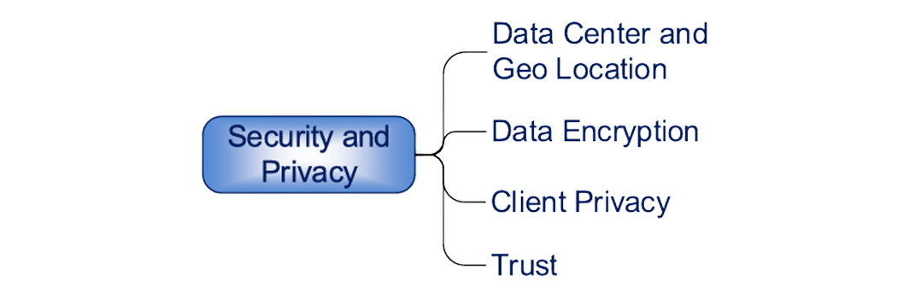


The UNIFIED CLOUD SERVICE MEASUREMENT INDEX
The UCSMI framework evaluates Cloud services based on eight key categories :
1.
Security and privacy
The KPIs to measure security and privacy are shown in Figure 1 .
FIGURE 1: KPIs to evaluate the security and privacy of cloud services.
Department of Computer Science & Engineering, Jagannath University
09

Slide 10
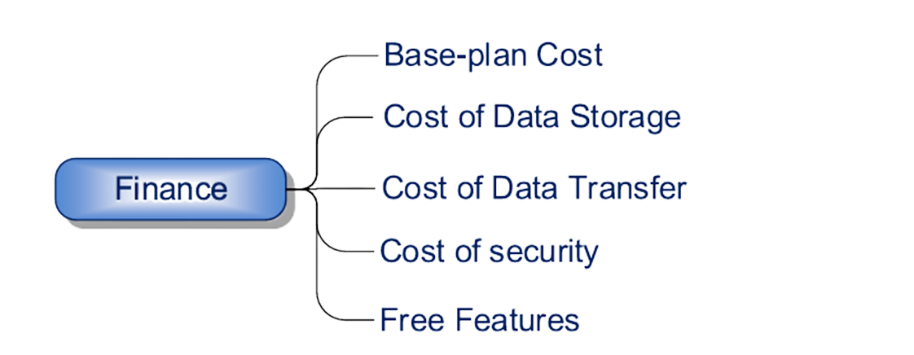
The UNIFIED CLOUD SERVICE MEASUREMENT INDEX (cont.)
2.
Finances
The KPIs to measure the finances are shown in Figure 2 .
FIGURE 2: KPIs to evaluate the financial aspects of cloud services.
Department of Computer Science & Engineering, Jagannath University
10

Slide 11

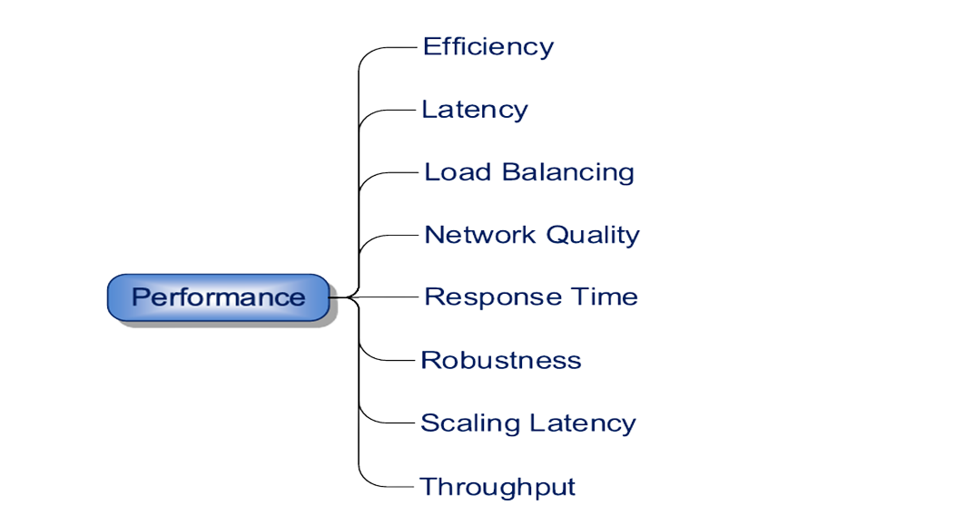
The UNIFIED CLOUD SERVICE MEASUREMENT INDEX (cont.)
3.
Performance
The Cloud service performance is measured using the KPIs shown in Figure 3.
FIGURE 3: KPIs to evaluate Cloud service performance.
Department of Computer Science & Engineering, Jagannath University
11

Slide 12
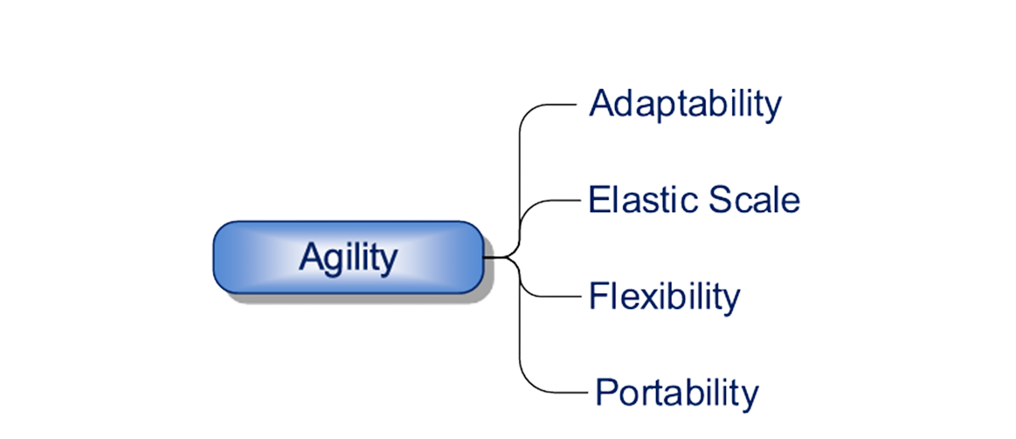
The UNIFIED CLOUD SERVICE MEASUREMENT INDEX (cont.)
4.
Agility
The KPIs to measure agility are shown in Figure 4.
FIGURE 4: KPIs to evaluate the agility of cloud services.
Department of Computer Science & Engineering, Jagannath University
12

Slide 13
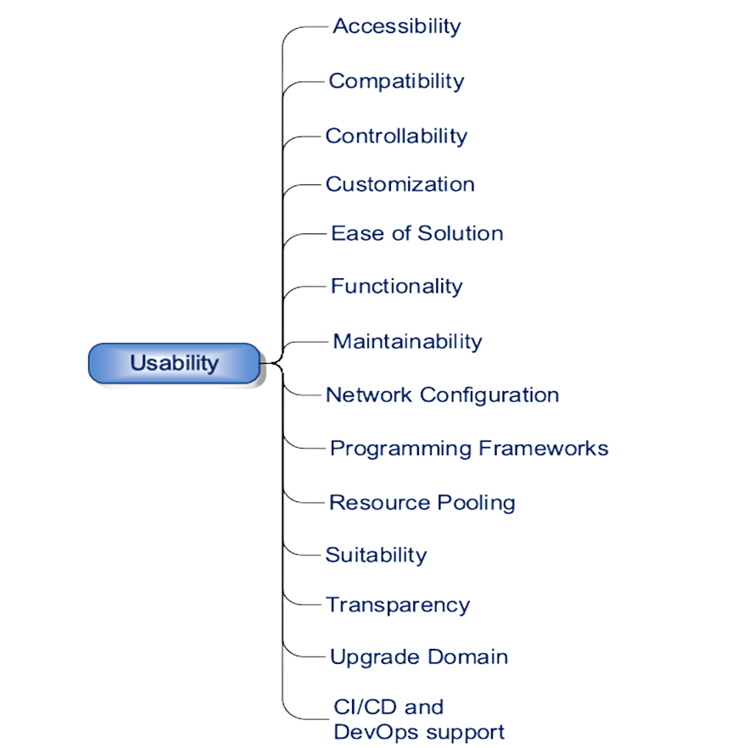
The UNIFIED CLOUD SERVICE MEASUREMENT INDEX (cont.)
5.
Usability
Usability of Cloud service is usually measured in terms of the KPIs shown in Figure 5
FIGURE: KPIs to evaluate the usability of cloud services.
Department of Computer Science & Engineering, Jagannath University
13

Slide 14
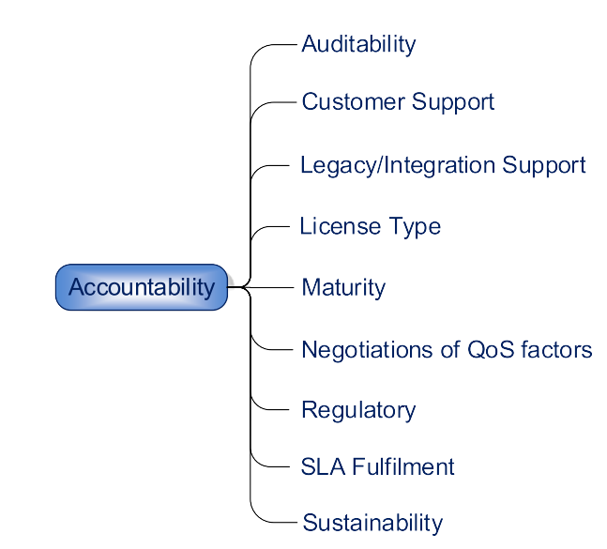
The UNIFIED CLOUD SERVICE MEASUREMENT INDEX (cont.)
6.
Accountability
The KPIs to measure accountability are shown in Figure 6.
FIGURE 6: KPIs for evaluation of accountability of cloud services.
Department of Computer Science & Engineering, Jagannath University
14

Slide 15
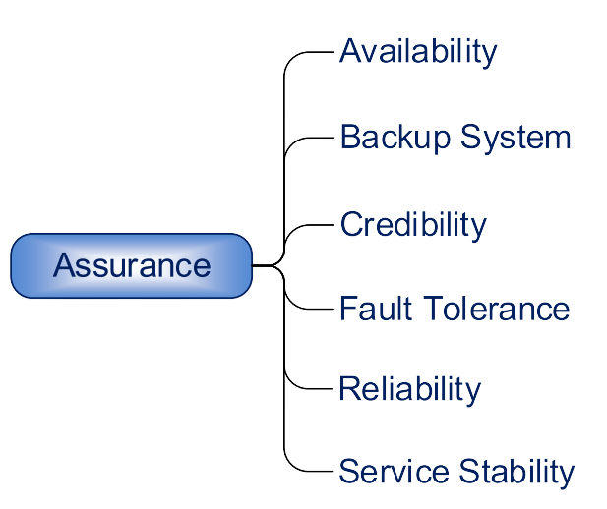
The UNIFIED CLOUD SERVICE MEASUREMENT INDEX (cont.)
7.
Assurance
The KPIs to measure assurance are shown in Figure 7.
FIGURE 7: KPIs for evaluation of assurance of cloud services.
Department of Computer Science & Engineering, Jagannath University
15

Slide 16
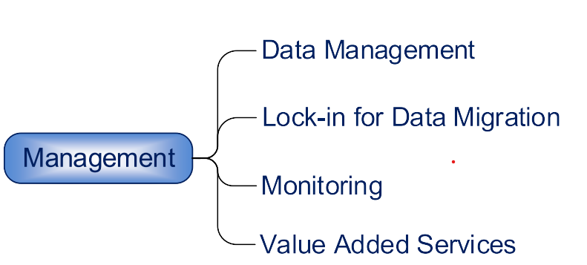
The UNIFIED CLOUD SERVICE MEASUREMENT INDEX (cont.)
8.
Management
The KPIs to measure management are shown in Figure 8.
FIGURE 8: KPIs for evaluate management of cloud services.
Department of Computer Science & Engineering, Jagannath University
16

Slide 17


MAGIQ Ranking Method
The paper describes the Multi-Attribute Global Inference of Quality (MAGIQ) Ranking Method as follows:
1.
Hierarchical Evaluation
2.
Weight Assignment Using Rank Order Centroids (ROC)
Cloud services are ranked using a structured hierarchy of attributes and KPIs.
Users can prioritize the attributes most important to them.
MAGIQ assigns weights to different attributes based on their importance.
The higher the rank, the higher the weight in calculations.
Department of Computer Science & Engineering, Jagannath University
17

Slide 18



MAGIQ Ranking Method (cont.)
3. Performance Calculation
Each cloud service is evaluated based on KPI measurements.
Scores are aggregated to compute a final ranking.
4. Flexibility
Users can choose all or only some attributes for ranking.
Works for both technical and non-technical users.
Department of Computer Science & Engineering, Jagannath University
18

Slide 19

MAGIQ Ranking Method (cont.)
4. Final Ranking
The cloud service with the highest overall score is ranked as the best option.
Department of Computer Science & Engineering, Jagannath University
19

Slide 20


Case Study – Ranking Cloud Services
Phase 1:
Ranked 6 cloud services based on real data.
Phase 2:
Steps:
Pick services.
Choose ranking factors.
Assign scores using MAGIQ.
Get final ranking.
Phase 3:
Results show best and worst cloud services.
Department of Computer Science & Engineering, Jagannath University
20

Slide 21

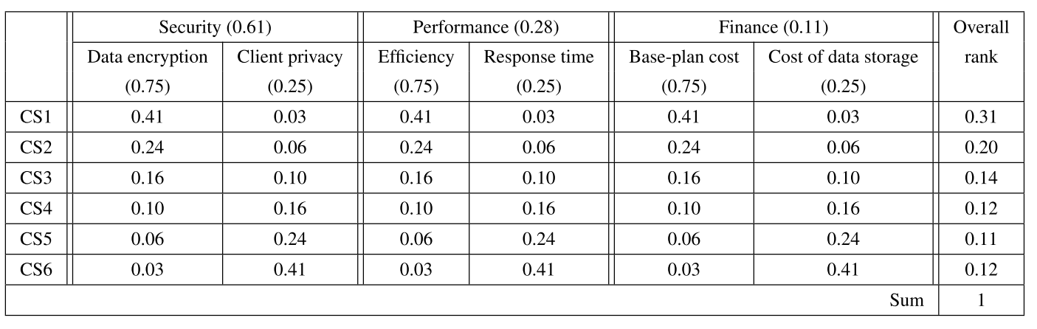
Result Analysis
Figure 9: Weights and overall rank of six Cloud services based on three top-level attributes and two KPIs for each attribute.
Department of Computer Science & Engineering, Jagannath University
21

Slide 22



Result Analysis
Evaluation of Performance
Some cloud services were more secure and reliable but also more expensive.
Others were cheaper but lacked features like strong encryption or customer support.
The best cloud service varied based on user needs.
Businesses preferred security & scalability, while individual users prioritized cost.
Department of Computer Science & Engineering, Jagannath University
22

Slide 23
Result Analysis
Key Findings
The MAGIQ method effectively ranked cloud services in a user-centric way.
No single cloud service was best for everyone—ranking depends on what users value most.
Department of Computer Science & Engineering, Jagannath University
23

Slide 24
Result Analysis
Why UCSMI + MAGIQ is Better
Other methods are rigid and complex.
UCSMI + MAGIQ is flexible & user-friendly.
Works for all types of cloud services.
Department of Computer Science & Engineering, Jagannath University
24

Slide 25
Future Works
The future includes using other evaluation and ranking methods that can exploit fuzzy as well as non-quantifiable performance information.
Also separate models for functional and nonfunctional KPIs can be developed
Department of Computer Science & Engineering, Jagannath University
25

Slide 26


Conclusion
Cloud services play an important role in modern computing, and choosing the right one can be challenging. This study introduced UCSMI and MAGIQ as effective methods for ranking cloud services based on user preferences. The framework provides a simple, flexible, and accurate way to compare services, helping users make better decisions. By considering key factors such as security, performance, and cost, users can select the cloud service that best fits their requirements.
Department of Computer Science & Engineering, Jagannath University
26

Slide 27


Thank You
Department of Computer Science & Engineering, Jagannath University
27

